Slide 1
Linear Algebra

Slide 2
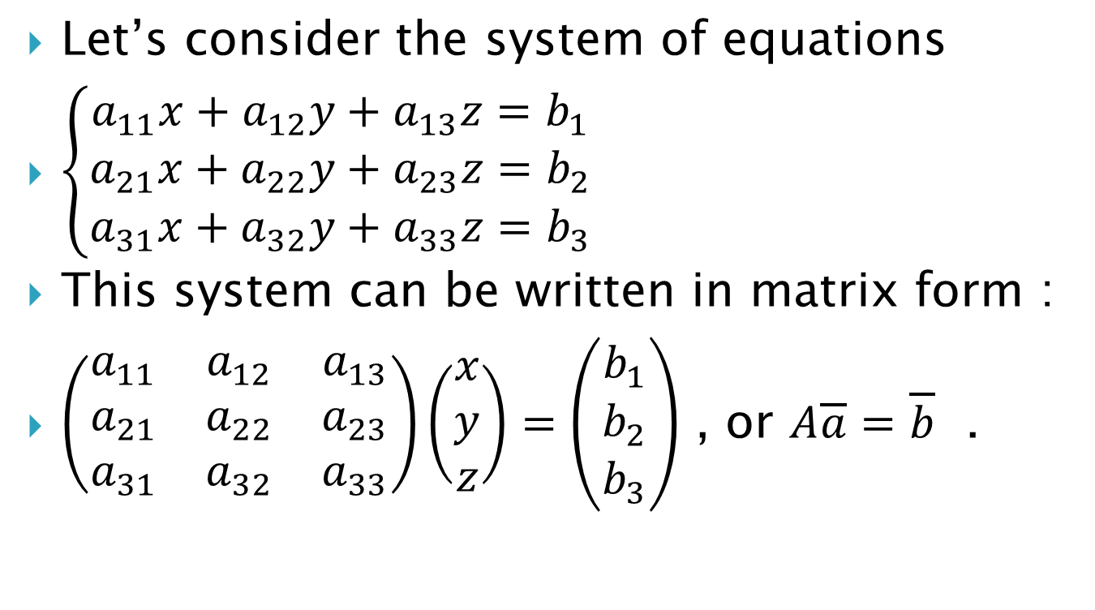
Linear Systems of Equations — Applications
Let’s consider the system of equations
$\left\{\begin{aligned}a_{11}x+a_{12}y+a_{13}z=b_{1} \\ a_{21}x+a_{22}y+a_{23}z=b_{2} \\ a_{31}x+a_{32}y+a_{33}z=b_{3}\end{aligned}\right.$
This system can be written in matrix form :
$\left(\begin{matrix}a_{11} & a_{12} & a_{13} \\ a_{21} & a_{22} & a_{23} \\ a_{31} & a_{32} & a_{33}\end{matrix}\right)\left(\begin{matrix}x \\ y \\ z\end{matrix}\right)=\left(\begin{matrix}b_{1} \\ b_{2} \\ b_{3}\end{matrix}\right)$ , or $A\overline{a}=\overline{b}$ .

Slide 3

Example 1. In one week, a math store sold $14$ calculators for a total of $\$1140$. Blue calculators cost $\$75$ each and silver calculators cost $\$85$ each. How many of each type of calculator were sold?

Slide 4
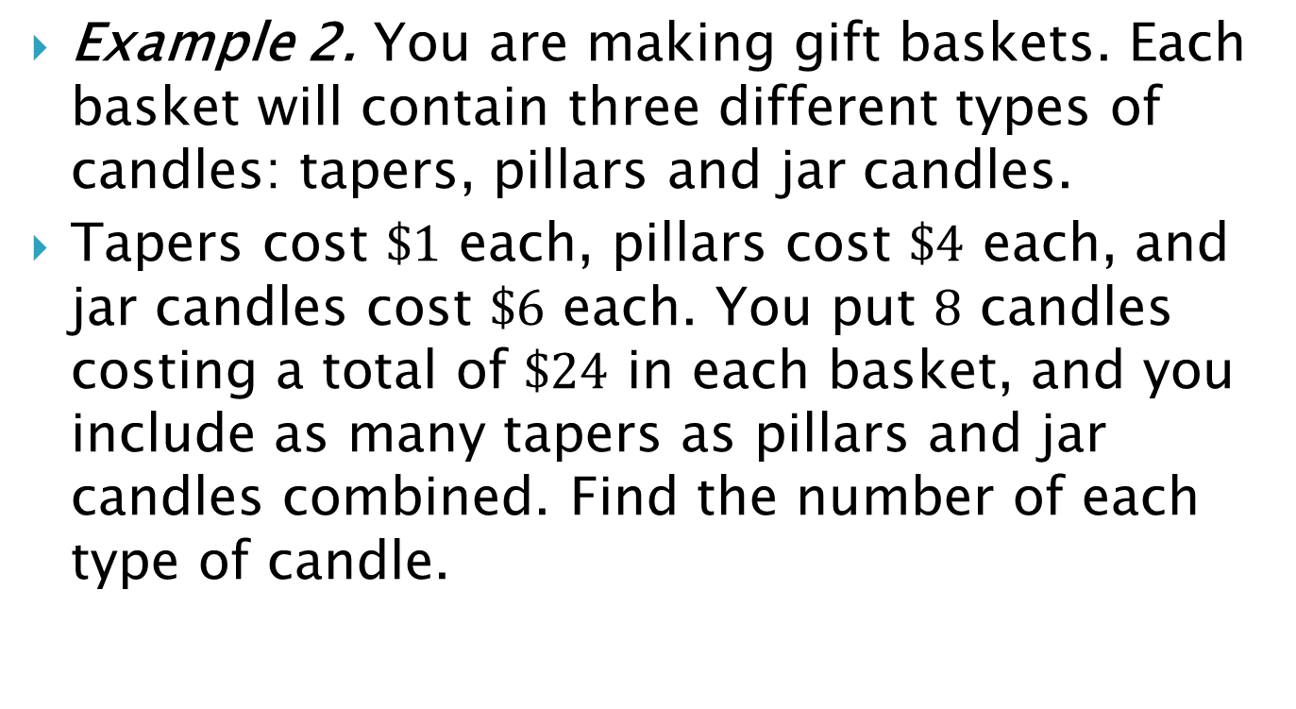
Example 2. You are making gift baskets. Each basket will contain three different types of candles: tapers, pillars and jar candles.
Tapers cost $\$1$ each, pillars cost $\$4$ each, and jar candles cost $\$6$ each. You put $8$ candles costing a total of $\$24$ in each basket, and you include as many tapers as pillars and jar candles combined. Find the number of each type of candle.

Slide 5
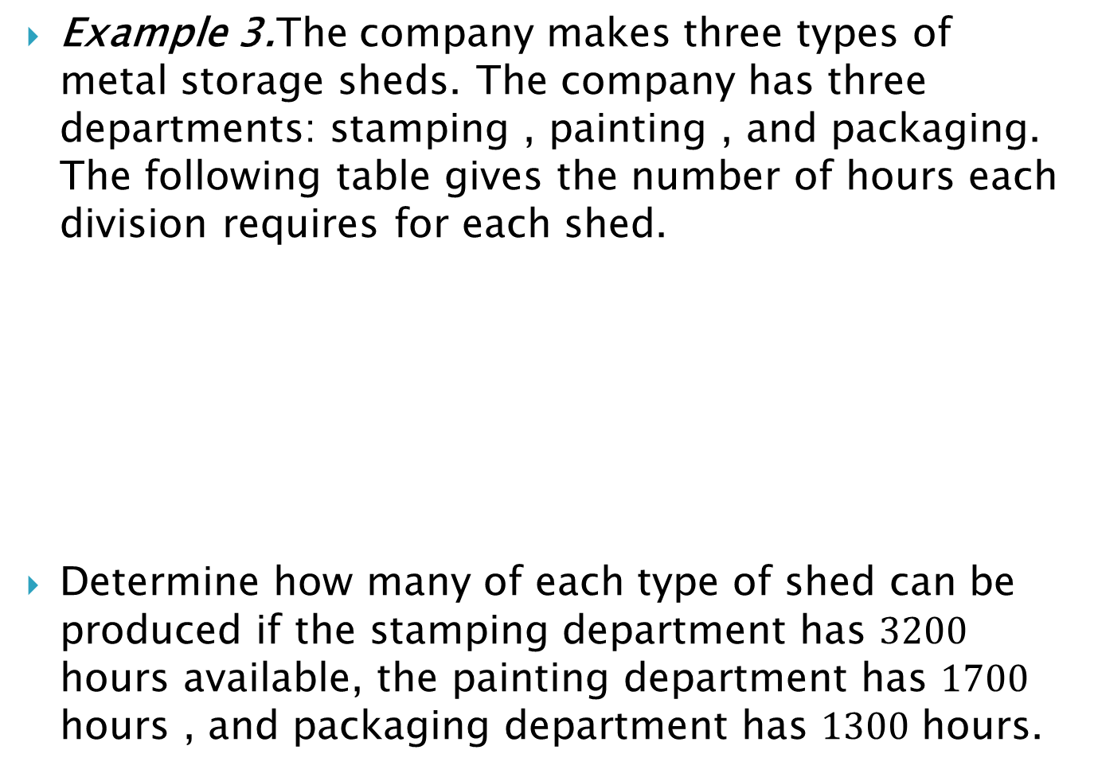
Example 3.The company makes three types of metal storage sheds. The company has three departments: stamping , painting , and packaging. The following table gives the number of hours each division requires for each shed.
Determine how many of each type of shed can be produced if the stamping department has $3200$ hours available, the painting department has $1700$ hours , and packaging department has $1300$ hours.
 | Shed
Departments | Type 1 | Type 2 | Type 3
Stamping | 2 | 3 | 4
Painting | 1 | 2 | 1
Packaging | 1 | 1 | 2

Slide 6
Example 4. A concert audience of 400 people consists of adults, students, and children. The ticket prices are $40 for adults, $20 for students, and $10 for children. The total amount of money taken in is $10600. The number of children tickets sold is in 200 less than the number of adult and student tickets in total. How many adults, students, and children are in attendance?

Slide 7
Example 5. There were 240 persons in a picnic. There were 20 more men than women and 20 more adults than children. How many men were there in the picnic ?

Slide 8
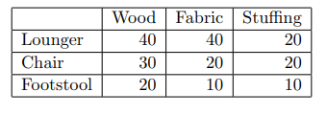
Example 6. A furniture company makes loungers, chairs, and footstools out of wood, fabric, and stuffing. The number of units of each of these materials needed for each of the products is given in the table below. How many of each product can be made if there are 1110 units of wood, 880 units of fabric, and 660 units of stuffing available? Just set up the problem.

